Slide 1
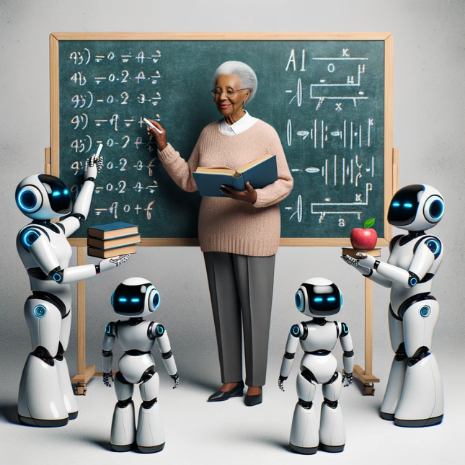

AI Assisted Learning
Image: DALL-E 3
Teachers as Coordinators of a Thousand Learning Agents
Dan McCreary
October 2023

Slide 2
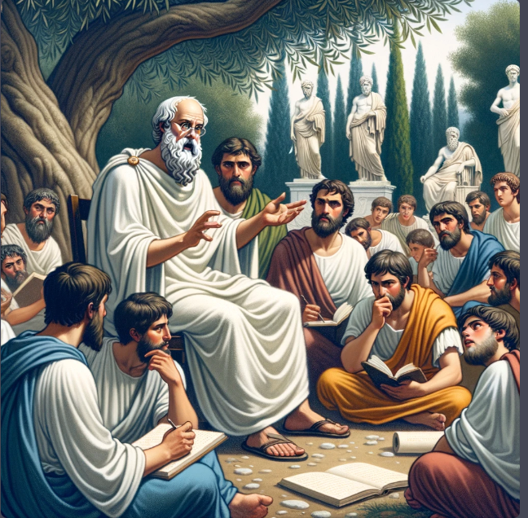
AI-Driven Learning
Learning will change more in the next five years than it has changed in the last 2,000 years. The cost of generating high-quality content is dropping in many areas such as image, software and text generation. The ability of generative AI tools like ChatGPT are allowing teachers to build lesson plans customized to each student. How will these trends impact the classrooms in Minnesota?

Slide 3
Audience Questions
How many people have used generative AI (ChatGPT)?
How many people have found it useful?
How many people use it every day?
How many people use the “Pro” version ($20/month)?
Would you pay per month to keep it?

Slide 4





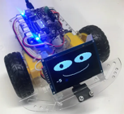


Background for Dan McCreary
Solution architect with over 35 years working with data
Worked for Bell Labs and Steve Jobs at NeXT
Author of a book on database selection “Making Sense of NoSQL”
Former Senior Distinguished Engineer working for Optum (UHG)
Built the worlds largest healthcare knowledge graph at Optum
Lead the “Generative AI Center of Excellence” at Optum
Worked with over 250 healthcare uses cases – 50 which were funded and over 10 in production
Blogger: http://medium.com/@dmccreary
Big fan of AI, robotics, MicroPython, and STEM education
Volunteer with Code Savvy since 2014
Advocate for neurodiversity

Slide 5
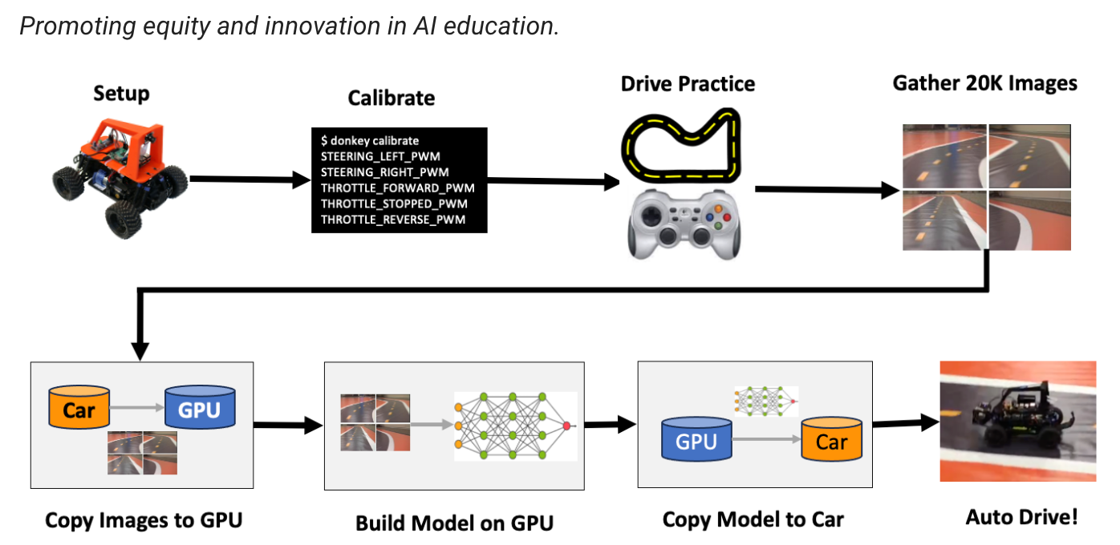
AI Racing League
https://www.coderdojotc.org/ai-racing-league/

Slide 6
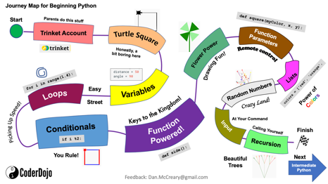
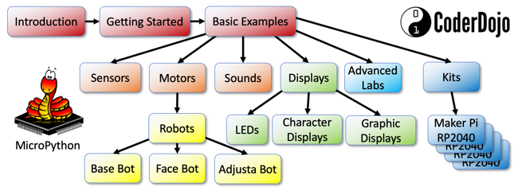
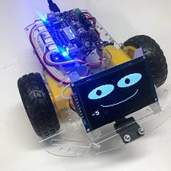
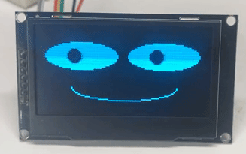
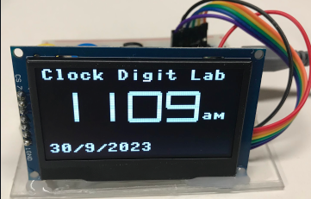
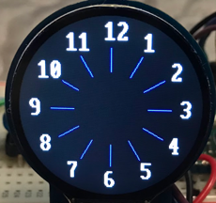
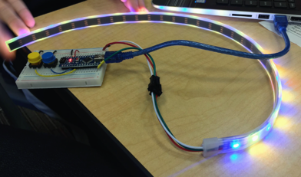
AI and Python Websites and Projects
Python
MicroPython (15K views/month)
$19 Python Robot
Python Robot Faces
Python
Smart Watches
Python
WiFi Clocks
Python LED Costumes

Slide 7
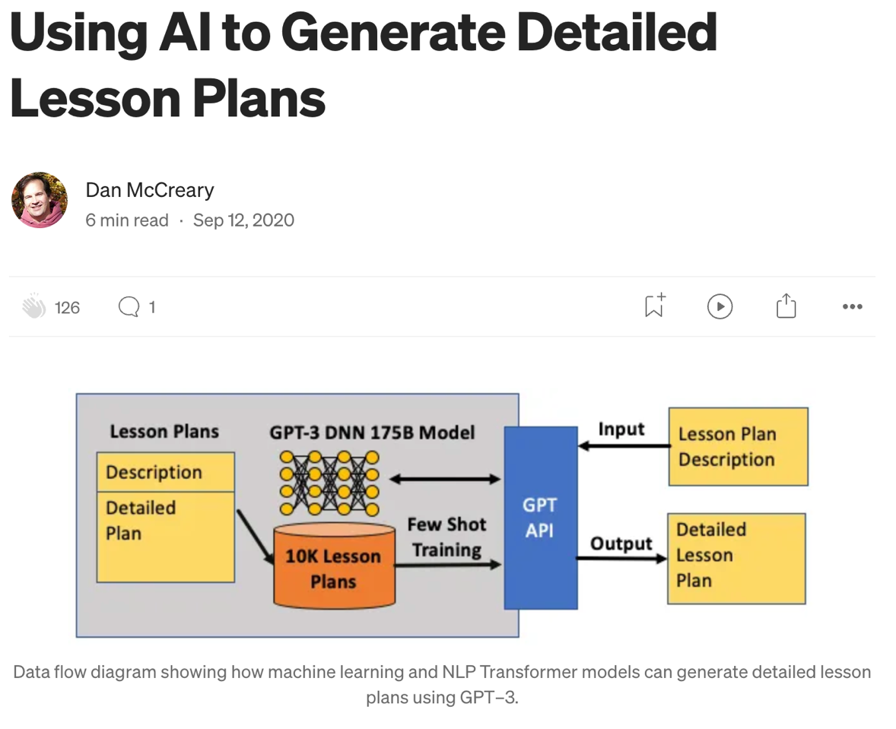
September 2020!
https://dmccreary.medium.com/using-al-to-generate-detailed-lesson-plans-29a5af200a6a

Slide 8
Facts
As of 2022, there are roughly 110,000 tech employees in Minnesota
The annual median tech wage is $94,715
In the next 10 years, Minnesota businesses will have to fill 81,000 tech jobs
45,000 in the next five years
Vacancies mostly from retirements and job changes to other states, according to the Minnesota Technology Association (MTA)
In that same span, there will be an additional 6,500 IT jobs
Minnesota projects to produce only 6,600 new tech workers by 2032, not nearly enough to address all the positions

Slide 9
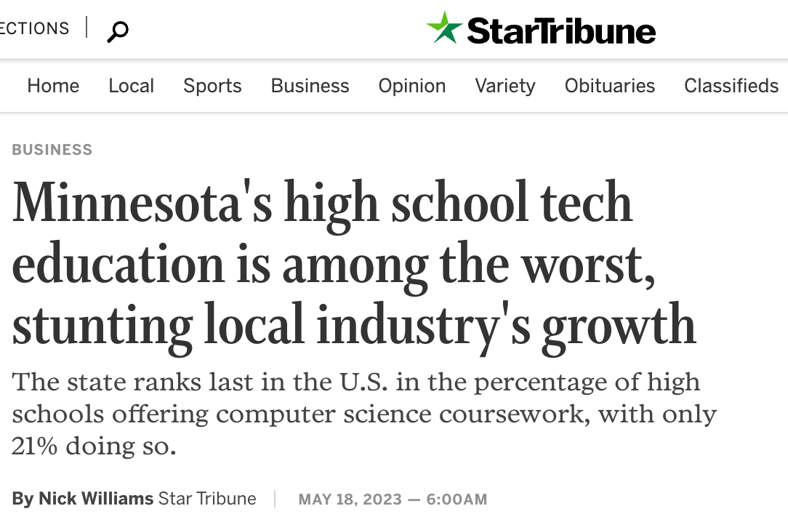
Minnesota is Last
https://www.startribune.com/minnesotas-high-school-tech-education-is-among-the-worst-stunting-local-industrys-growth/600275879

Slide 10
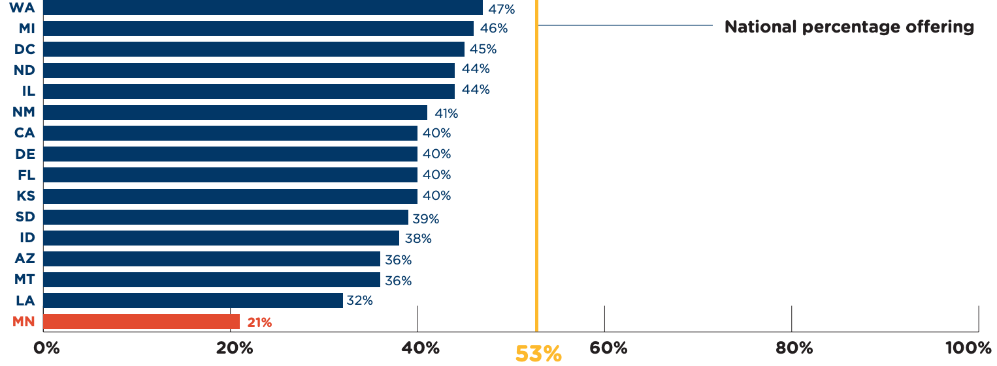
Percentage of High Schools Offering Computer Science
https://advocacy.code.org/state-handouts/Minnesota.pdf

Slide 11
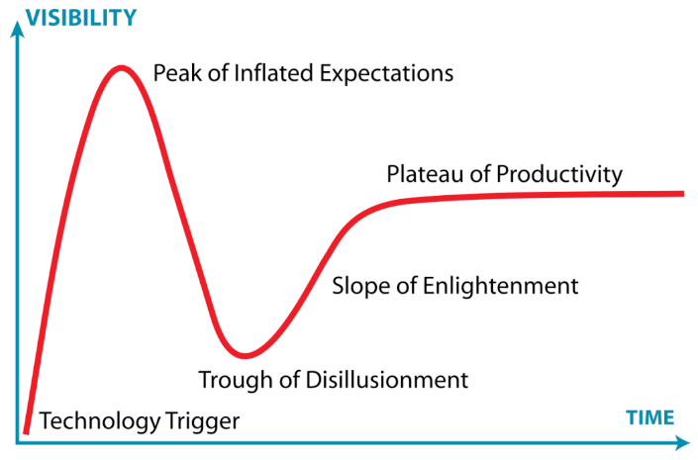
The Hype Cycle for Generative AI

Slide 12
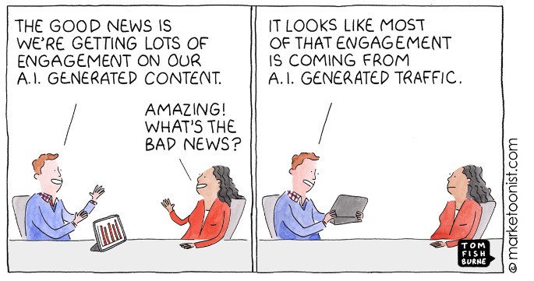
The Dropping Cost of Content

Slide 13
Key Trends
Generative AI for simple lesson plans
Generative AI for customization of lesson plans
Generative AI for the generation of animations and simulations
Generative AI for promoting strategic change
Cooperative generative AI agents

Slide 14
Cooperating Agents
Today
Next Year
Single prompt
Single Large-language model (LLM)
LLMs generate code
Executed code generates prompts
Example: ChatGPT Advanced Data Analytics
Hundreds of agents interacting
Agents calling services and databases
Learning management systems (LMS) suggestion courses, exercises and labs
LLM
LMS
User
LLM
Code
DB
User
3-Agents
Code

Slide 15


Consider the Busy Teacher
One teacher
30 students
1 lesson plan

Slide 16
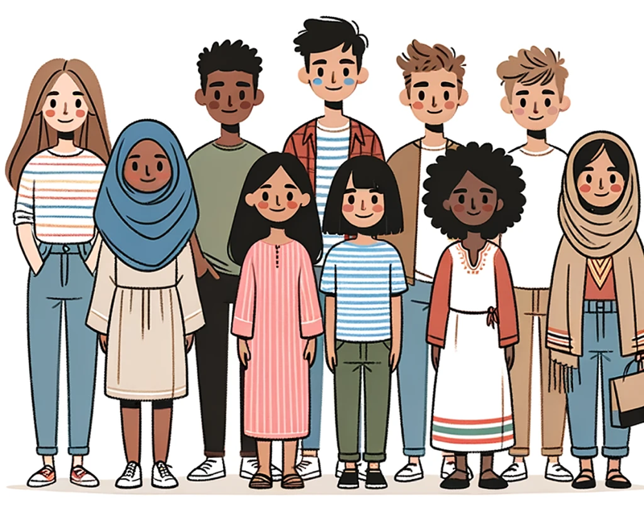
Fact: No Two Students are Alike
Different backgrounds in math
Different first languages - not all English native speakers
Different levels of curiosity
Different amounts of sleep last night
Image: DALL-E 3

Slide 17
Not all students learn at the same rate
Number of Students at Rate
Target
Rate
Medium Learners
Slower Learners
Faster Learners
Learning Rate

Slide 18
What Happens?
Faster learners get board
Faster learners lose interest
Faster learners get frustrated

Slide 19

But What If The Teacher Could…
Quickly generate many customized interactive lesson plans
Use the prior week’s quiz to customize the lesson plans
Does this work today? YES!
ChatGPT Prompt: Generate three lesson plans for a session on using the sine and cosine function to draw the hands of a clock. The first lesson plan is for students that need extra help and don't have a strong background in math. The second lesson plan is for students that learn faster and pick up new ideas in a short amount of time. The third lesson plan is for advanced students that quickly master concepts and would like to apply their knowledge to other areas.

Slide 20
Yes, It Works!
Lesson Plan 1: For Students Needing Extra Time
Objective: To understand the basic concepts of the sine and cosine functions and their relationship with the hands of a clock.
Introduction:
Discuss the face of a clock and how it represents a circle.
Introduce the concept of the unit circle.
Basic Trigonometry Introduction:
Discuss right triangles and the basic trigonometric ratios.
Introduce the sine and cosine functions as they relate to right triangles.
Clock Hands and Trigonometry:
Discuss the rotation of clock hands and the angles they create.
Use a manipulative or model clock to show the motion of hands.
Relate the position of the hour and minute hands to angles.
.
Lesson Plan 3: For Advanced Students
Objective: To master the use of the sine and cosine functions for clock hands and extend the knowledge to more complex scenarios.
Introduction:
Quick recap of sine and cosine with the unit circle and clock analogy.
Deep Dive into Circular Motion:
Introduce radians as another measure of angles.
Explain the relationship between degrees and radians.
Activity:
Challenge students to convert clock times into radians.
Compute sine and cosine values in terms of π.
Advanced Application:
Introduce the concept of parametric equations.
Task students to come up with parametric equations that describe the motion of clock hands using sine and cosine.
Extension:
Discuss the application of sine and cosine in physics (e.g., pendulum motion, oscillations).
Chat Transcript https://chat.openai.com/share/d043e4a0-eb4c-4a63-8b7c-90f504a76866:

Slide 21
What About Static Textbooks?
Static text
Static diagrams
Compared to Tic-Toc
…Boring, boring, boring
Can AI Generate Fun Interactive Simulations?

Slide 22
Make me a Simulation…
ChatGPT Prompt: Generate a p5.js sketch file of a simulation of a static pulse width modulation (PWM) waveform on a 300x600 canvas.
Add a range control slider to adjust the duty cycle of the waveform
with a default value of 50%. The minimum should be 0% and the maximum should be 100%.
Make sure the range control slider has a width of 400px using the style attribute.
At the end of the draw() function add a text() function that displays
the label and value of the duty cycle.

Slide 23
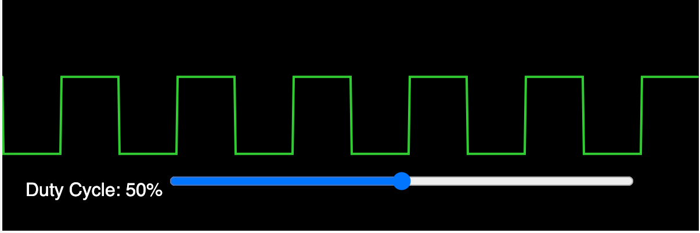
Pulse Width Modulation Demo
Interactive slider
https://www.coderdojotc.org/chatgpt-for-teachers/demos/p5/pwm.html

Slide 24
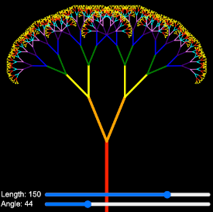
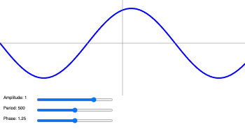
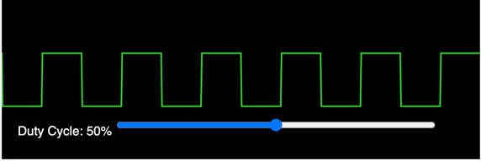
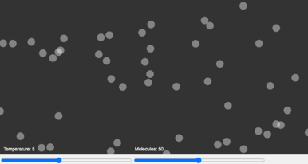
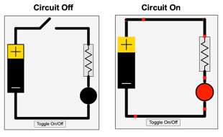
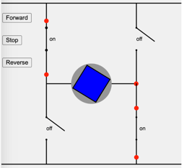
Simulation Generation
Prompt: Create a simulation of : ________
A Sine Wave
Pulse Width Modulation
Recursion
An LED Circuit
A Gas Chamber
An H-Bridge Circuit
https://www.coderdojotc.org/chatgpt-for-teachers/demos/p5/

Slide 25

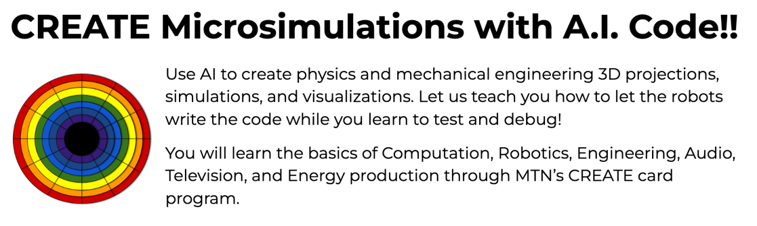
Val Lockhart’s MicroSims
https://sites.google.com/view/p5jsai/

Slide 26
Call to Action!
ChatGPT Prompt: What changes could Minnesota make to the K-12 curriculum to create more tech workers?

Slide 27
Results: 1 of 3
To create more tech workers and foster a tech-ready generation in Minnesota's K-12 system, the state could consider implementing the following changes to the curriculum:
Early Introduction to Computer Science: Start with basic coding and computer literacy classes in elementary school. This helps children become familiar with tech concepts from a young age.
Enhanced Tech Curriculum: In middle and high school, offer courses in programming languages, web development, app development, data science, and more.
Project-Based Learning: Introduce tech-based projects that allow students to solve real-world problems. This gives students practical experience and helps them understand the real-world applications of their knowledge.
Tech Clubs and Competitions: Encourage schools to offer extracurricular activities such as coding clubs, robotics teams, and participation in national and international tech competitions.

Slide 28
Results: 2 of 3
Professional Development for Teachers: Regularly train teachers to ensure they are up-to-date with the latest tech advancements and can effectively teach these concepts to students.
Partnerships with Tech Companies: Collaborate with tech companies for internships, mentorship programs, and guest lectures. This gives students exposure to the tech industry and potential career paths.
Tech Career Awareness: Introduce students to the variety of tech careers available, from software engineering to UI/UX design to cybersecurity, through career fairs and talks.
Incorporate Soft Skills: While technical knowledge is crucial, soft skills like problem-solving, critical thinking, teamwork, and communication are also essential in the tech industry. Make sure these are part of the curriculum.

Slide 29
Results: 3 of 3
Diversity and Inclusion: Ensure that tech education is inclusive and promotes diversity. Reach out to underrepresented groups in tech, including girls, minority students, and those from low-income backgrounds.
Update Infrastructure: Ensure schools have the necessary infrastructure, including updated computers, software, and fast internet connectivity, to support tech education.
Hands-on Experiences: Incorporate more hands-on experiences like field trips to tech companies, hackathons, and workshops.
Online Resources: Provide students with access to online resources and platforms where they can learn at their own pace, practice coding, and take on challenges.
Continuous Evaluation: Regularly assess and update the tech curriculum to ensure it aligns with industry needs and advancements.

Slide 30
Summary
By implementing these changes and continually evaluating the curriculum's effectiveness, Minnesota can foster a tech-savvy generation ready to take on roles in the ever-evolving tech industry.

Slide 31
Resources
Code Savvy: https://www.codesavvy.org
Generative AI for Teachers: https://www.coderdojotc.org/chatgpt-for-teachers/

Slide 32
Questions
Thank You!
LinkedIn: https://www.linkedin.com/in/danmccreary
Blog: http://medium.com/@dmccreary
Slides: https://github.com/CoderDojoTC/ai-racing-league/blob/master/slides/AI-Assisted-Learning.pptx

